Slide 1
Haptic Horizon
Sean Balbale, Johanna Woldeher, Crystal Kim, Donovan Chang
12/04/2024

Slide 2
How things should be organized
Why we did the project/ background
How it was built/ manufactured- Donovan
How it works- Sean
What we can learn from this and improve

Slide 3
In your explanations you need to mention in details: What your design does exactly and how, what is the mechanism you use in your robot to make it fit for doing the task and what methodology you use for building it (3D printer, types of sensor, ...)
Used
Arduino, breadboard, 9V battery, DC motor, and 4 ultrasonic sensors, and a 3d printed body
Designed to be wearable.. Sorta big so would preferably end up using smaller motors, better and smaller sensors, and solder everything, so that able to use smaller body.
But design so far is built to house everything but the motos which is attached on the outside and provides the vibration aspect to when it detects anything.

Slide 4
How it works?
Parts Used:
4 ultrasonic sensors
1 hobby gear motor
Code Explanation:
The purpose of the code is to spin the motor when an object gets within a certain distance of an ultrasonic sensor.
The code is designed to be adjustable so it can be tailored to the individual user

Slide 5
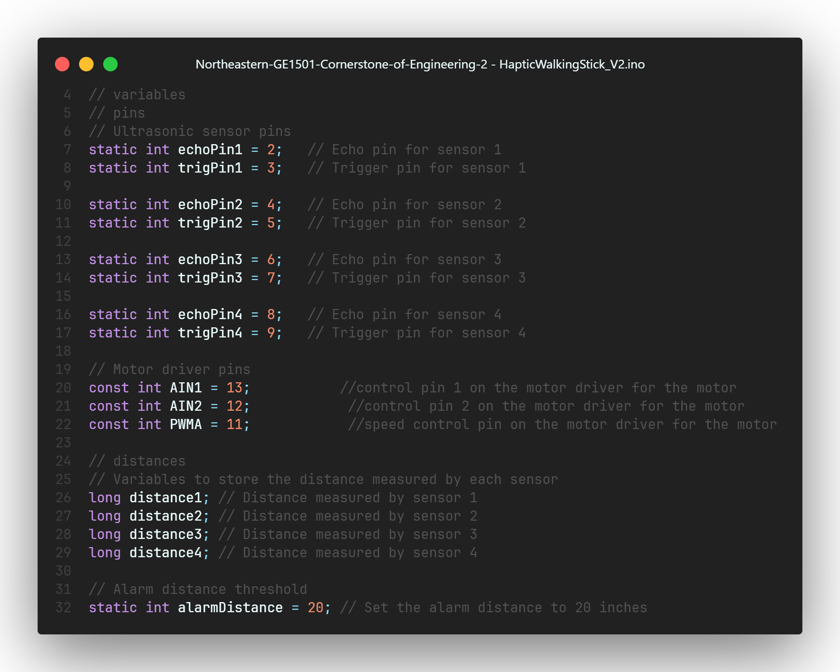
Code Explanation Continued…
These are the variables used.
Pins 2 through 9 are used for the ultrasonic sensors.
Pins 11 through 13 are for the motor controller.
The final variables are for the alarm distance and for the distance measurements from the ultrasonic sensor.

Slide 6
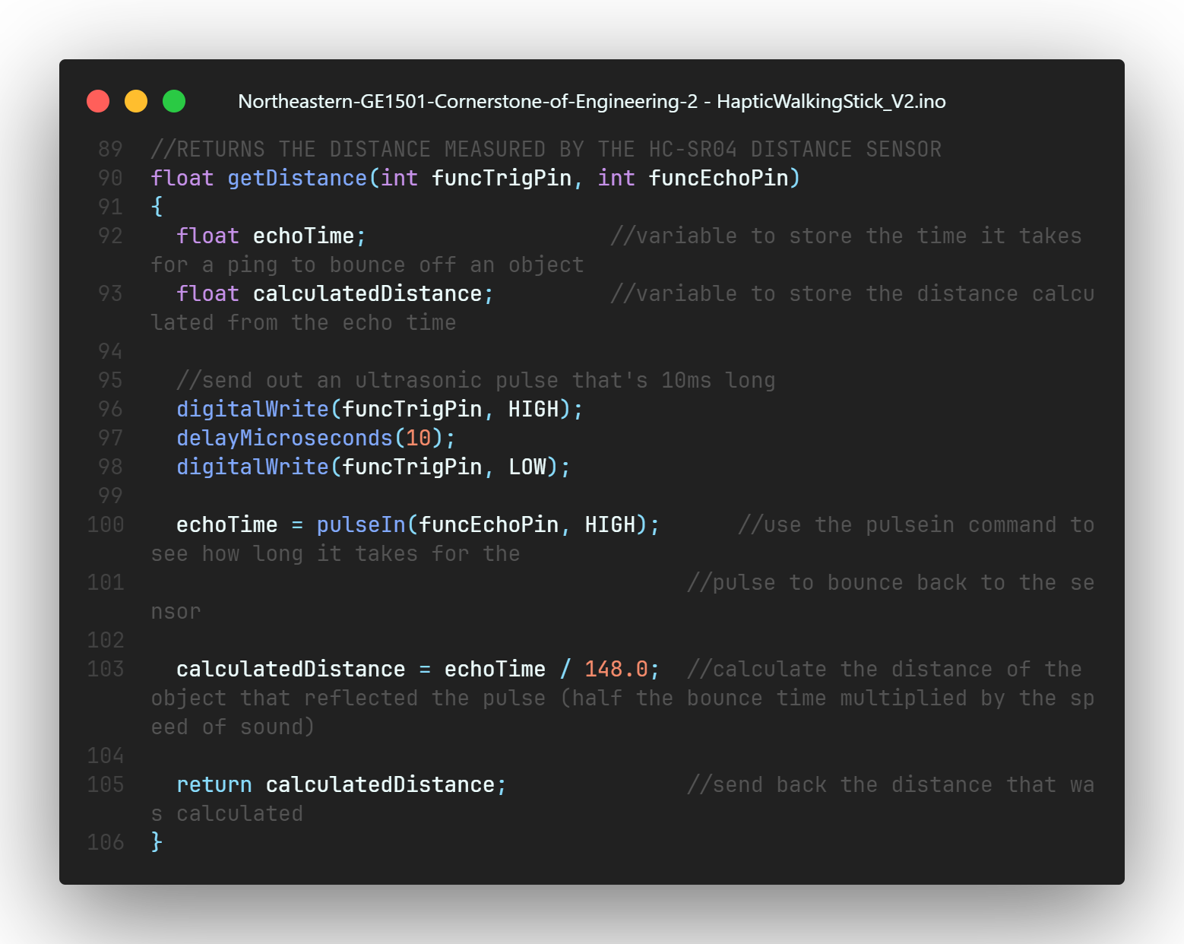
Code Explanation Continued…
getDistance Function.
This function calculates the distance an object is away from the ultrasonic sensor.
It pulses sound and records the time it takes to bounce back. Then it divides by a constant.
Finally it returns the distance.

Slide 7
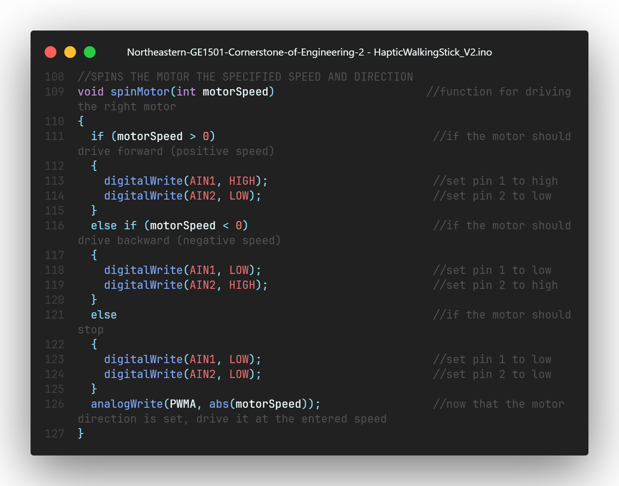
Code Explanation Continued…
spinMotor Function.
This function spins the motor a specified speed.
It checks to see if the motorSpeed is positive or negative. Then it spins in the associated direction.

Slide 8
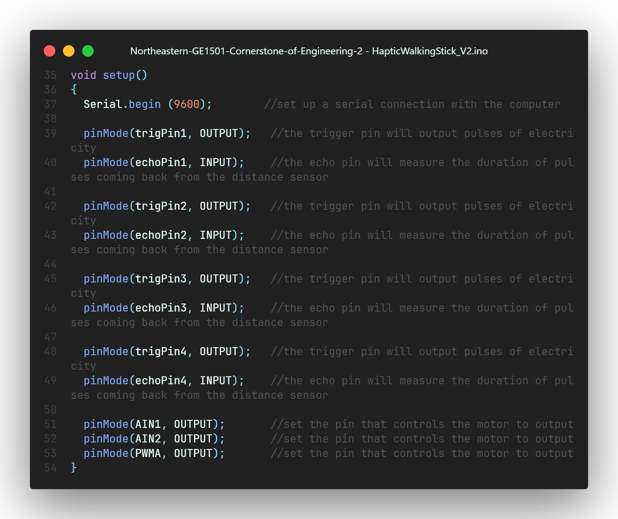
Code Explanation Continued…
setup Function.
It opens a serial port so that the program can communicate to the user.
Then it sets input and output pins for the ultrasonic sensors.
Finally, it sets output pins for the motor driver.

Slide 9
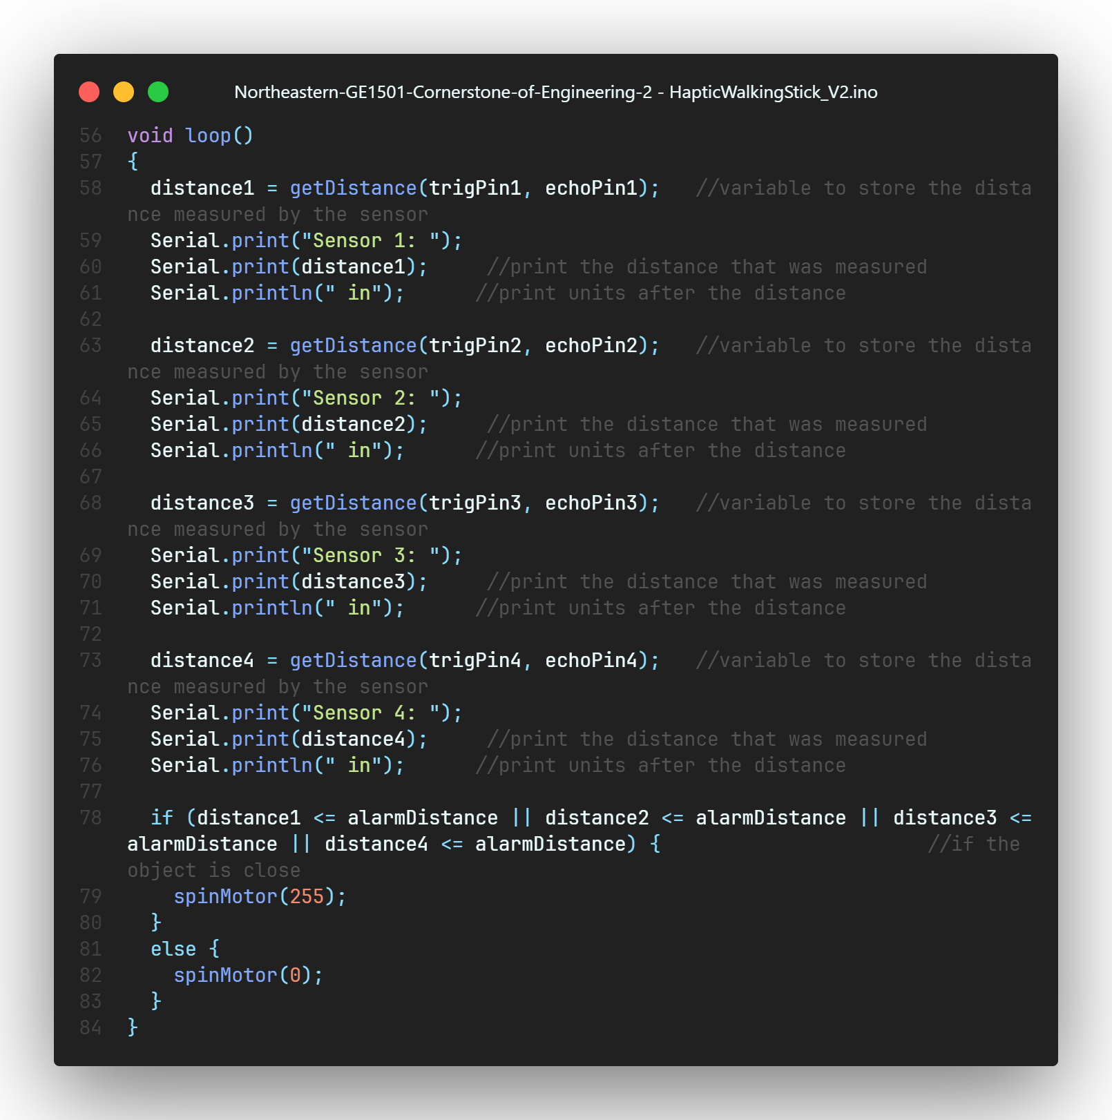
Code Explanation Continued…
loop Function.
These are the functions that loop automatically.
For each sensor it calls getDistance and then saves the distance to a variable and prints out the distance to the serial monitor.
Then it does some logic to see if it needs to spin the motor.

Slide 10
Subtasks
It must detect objects in front of it
It must vibrate when an object is detected
It must be wearable

